Slide 1
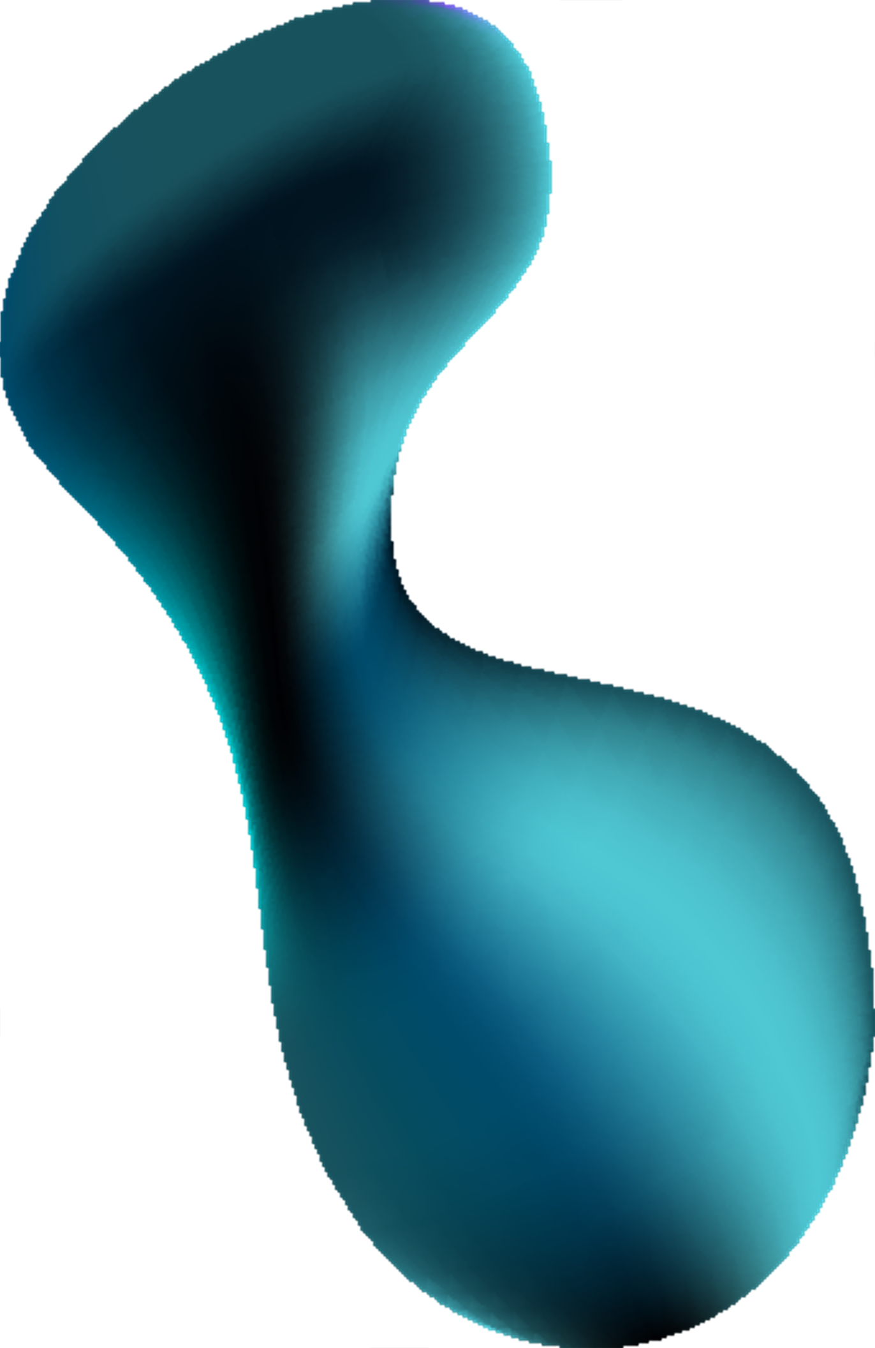



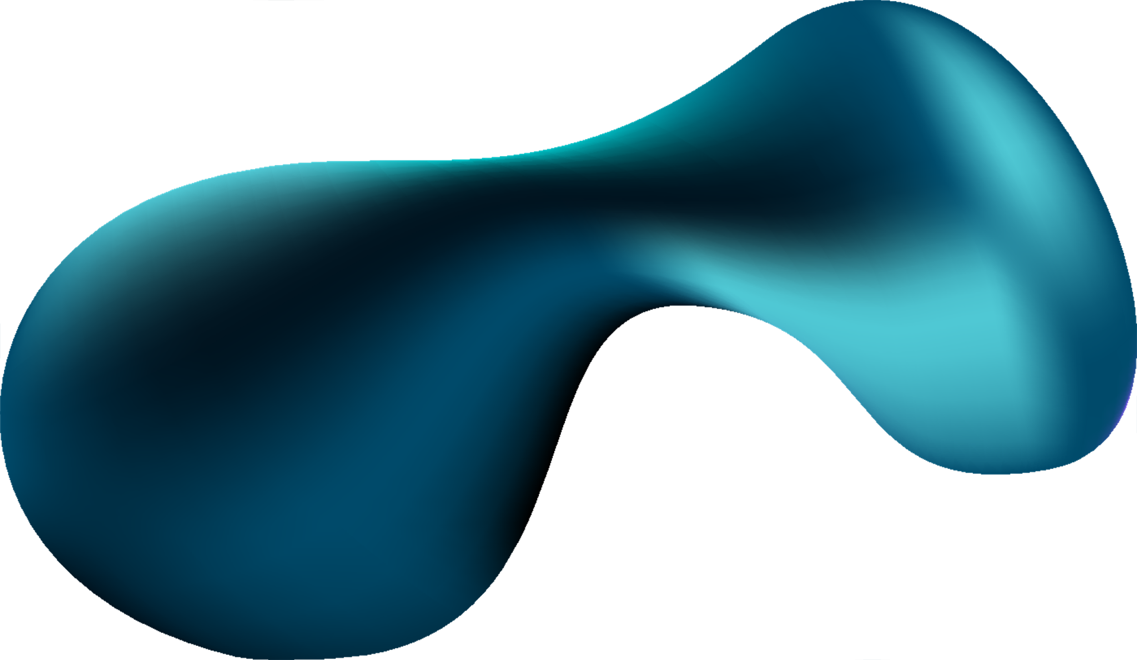


Slide 3


Meet our team

Slide 4




Meet our team
Bellimam Ahmed

Slide 5
Meet our team
Bellimam Ahmed
Dahdouh Rihab

Slide 6
Meet our team
Bellimam Ahmed
Dahdouh Rihab
Kahlaouinate Saad

Slide 7
Meet our team
Bellimam Ahmed
Dahdouh Rihab
Kahlaouinate Saad
Messaoudi Omar

Slide 8
Internship Application
?

Slide 9
Internship Application
?
Aya, a 3rd year student at ENSA Kénitra has just found out that she has to learn using Angular framework in her first internship. This news pushed her to ask herself questions about the usefulness and the ease of use of these technologies.

Slide 10

Meet our team
Internship Application
Problematic

Slide 11

Our study Goals :
Problematic ?

Slide 12
Our study Goals :

Slide 13
Our study Goals :
1
Identifying the computer engineering student's perception on adopting frameworks
2
Identifying the core factors behind the students’ use of frameworks

Slide 14

Our study Goals :
Documentation
1
Identifying the computer engineering student's perception on adopting frameworks
2
Identifying the core factors behind the students’ use of frameworks

Slide 15
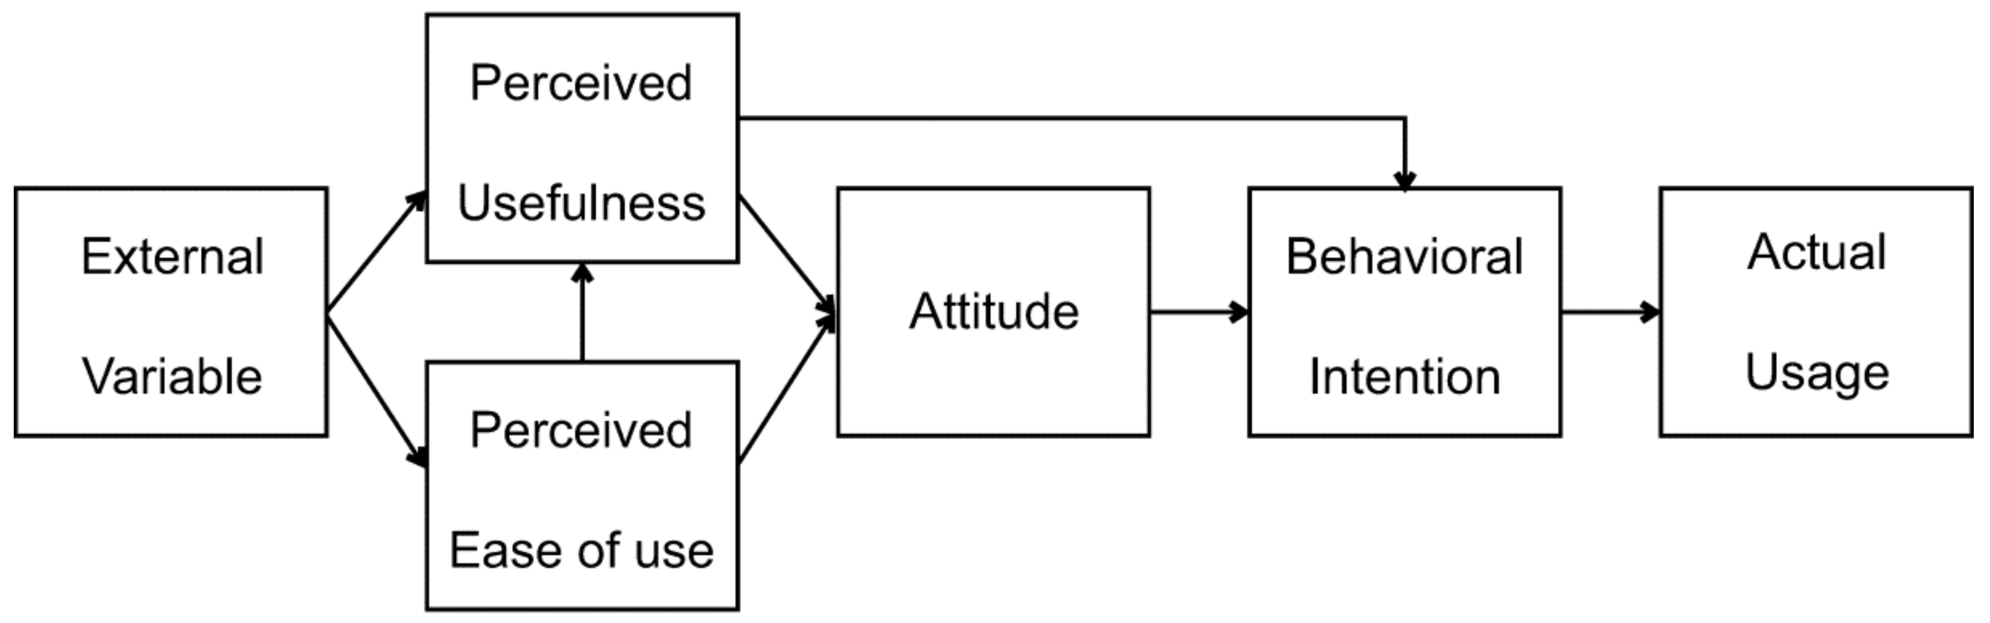
Our study Goals :
Documentation
1
Identifying the computer engineering student's perception on adopting frameworks
The Technology Acceptance Model (TAM) is a model dedicated to studying the adaptation of technological means in relation to user comfort and attitude. It is an application of the Theory of Reasoned Action (TRA) as a model of social psychology where it is determined whether an individual accepts or refuses to use a technological means (mainly computer-based).
2
Identifying the core factors behind the students’ use of frameworks

Slide 16
Our study Goals :
Documentation
The TAM model is based on individual analysis to determine:
1
Identifying the computer engineering student's perception on adopting frameworks
Perceived usefulness: analysis in terms of personal effectiveness and the improvement of work performance that a technological tool brings to its user.
Perceived ease of use: refers to the degree to which a person believes that using a system will be effortless. It also affects attitude towards use and behavioral intention.
2
Identifying the core factors behind the students’ use of frameworks

Slide 17
Our study Goals :
Documentation
Perceived usefulness: analysis in terms of personal effectiveness and the improvement of work performance that a technological tool brings to its user.
Perceived ease of use: refers to the degree to which a person believes that using a system will be effortless. It also affects attitude towards use and behavioral intention.
1
Identifying the computer engineering student's perception on adopting frameworks
2
Identifying the core factors behind the students’ use of frameworks
Behavioral intention: This is the core of the TAM. It is through this that we determine whether the user will reuse the technology.

Slide 18
Our study Goals :
Documentation
1
Identifying the computer engineering student's perception on adopting frameworks
2
Identifying the core factors behind the students’ use of frameworks

Slide 19

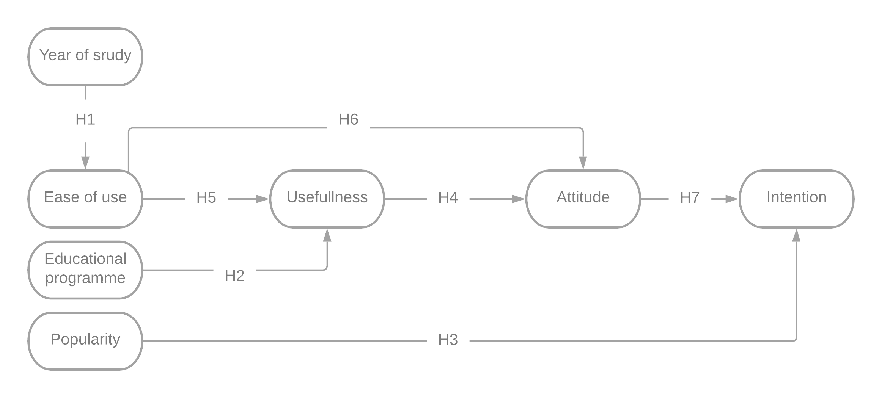
Documentation
Data Dictionary
Variable | Definition | Nature | Modality | Category
Name | Student’s full name | A | _ | explanatory
Age | Student’s age | N | Between 20 and 25 | explanatory
Gender | Student’s gender | A | H/F | explanatory
Year of study | Student’s year of study | A | 1st year/2nd year | explanatory
Ease of use | the degree to which frameworks are perceived as being easy to use or operate by students | A | Totally agree/ agree/ neutral/ disagree/ totally disagree | explanatory
Usefulness | the perceived value or utility that frameworks offer to students | A | Totally agree/ agree/ neutral/ disagree/ totally disagree | explanatory
Attitude | psychological and evaluative disposition or stance that students holds towards frameworks | A | Totally agree/ agree/ neutral/ disagree/ totally disagree | explanatory
Intention | Students’ deliberate commitment or resolve to use frameworks | A | Totally agree/ agree/ neutral/ disagree/ totally disagree | to be explained
Popularity | public or social approval and recognition that frameworks receives | A | Totally agree/ agree/ neutral/ disagree/ totally disagree | explanatory
Educational program | education that aims to impart knowledge, skills, and competencies to learners within a defined framework | A | Totally agree/ agree/ neutral/ disagree/ totally disagree | explanatory
1
Identifying the computer engineering student's perception on adopting frameworks
2
Identifying the core factors behind the students’ use of frameworks

Slide 20
Data Dictionary
Conceptual Model Of Research

Slide 21
Conceptual Model Of Research
Questions Of Research

Slide 22
Questions Of Research
1
What influences the use of frameworks ?
2
What encourages the use of frameworks ?
3
What attitude does the computer science students of ENSA Kenitra have towards the Frameworks ?

Slide 23
Questions Of Research
1
What influences the use of frameworks ?
2
What encourages the use of frameworks ?
3
What attitude does the computer science students of ENSA Kenitra have towards the Frameworks ?

Slide 24
Questions Of Research
1
What influences the use of frameworks ?
2
What encourages the use of frameworks ?
3
What attitude does the computer science students of ENSA Kenitra have towards the Frameworks ?

Slide 25
Hypothesis Of Research
Questions Of Research
The year of study affects the difficulty using frameworks
H1
H3
H5
1
What influences the use of frameworks ?
2
What encourages the use of frameworks ?
H2
H4
H6
3
What attitude does the computer science students of ENSA Kenitra have towards the Frameworks ?

Slide 26
Hypothesis Of Research
The year of study affects the difficulty using frameworks
H1
H3
H5
The pedagogical program doesn’t influence the usefulness of frameworks
H2
H4
H6

Slide 27
Hypothesis Of Research
The year of study affects the difficulty using frameworks
Popularity of frameworks is a major factor in adopting frameworks
H1
H3
H5
The pedagogical program doesn’t influence the usefulness of frameworks
H2
H4
H6

Slide 28
Hypothesis Of Research
The year of study affects the difficulty using frameworks
Popularity of frameworks is a major factor in adopting frameworks
H1
H3
H5
The pedagogical program doesn’t influence the usefulness of frameworks
H2
Frameworks are not useful for an engineer
H4
H6

Slide 29
Hypothesis Of Research
The year of study affects the difficulty using frameworks
Popularity of frameworks is a major factor in adopting frameworks
The ease of frameworks influence the utility
H1
H3
H5
The pedagogical program doesn’t influence the usefulness of frameworks
H2
Frameworks are not useful for an engineer
H4
H6

Slide 30
Hypothesis Of Research
The year of study affects the difficulty using frameworks
Popularity of frameworks is a major factor in adopting frameworks
The ease of frameworks influence the utility
H1
H3
H5
The pedagogical program doesn’t influence the usefulness of frameworks
H2
Frameworks are not useful for an engineer
H4
The simplicity of frameworks make the learning easier
H6

Slide 31
Hypothesis Of Research
The year of study affects the difficulty using frameworks
Popularity of frameworks is a major factor in adopting frameworks
The ease of frameworks influence the utility
H1
H3
H5
The pedagogical program doesn’t influence the usefulness of frameworks
H2
Frameworks are not useful for an engineer
H4
The simplicity of frameworks make the learning easier
H6
A positive attitude toward frameworks influence the will of use
H7

Slide 32

Targeted Population
1st and 2nd year computer science students of the national school of applied science Kenitra

Slide 33

Targeted Population
1st and 2nd year computer science students of the national school of applied science Kenitra
Our targeted population has a total of : 129 students
The Sample

Slide 34
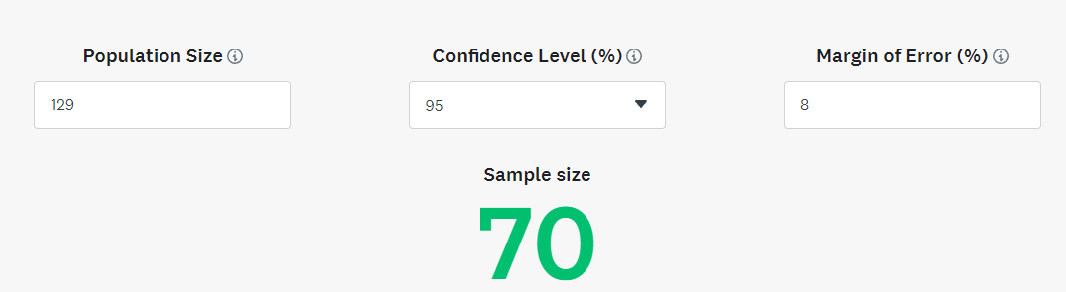
Targeted Population
The Sample

Slide 35
Targeted Population
Our Sample is : balanced
Our probability sampling plan is : stratified choice
1st year : 73
2nd year : 56
The Sample

Slide 36

Data Collection
Our Sample is : explanatory
Our probability sampling plan is : stratified choice
The Sample

Slide 37
Data Collection

Slide 38
Data Collection

Slide 39


Data Collection
Interviews
Form

Slide 40



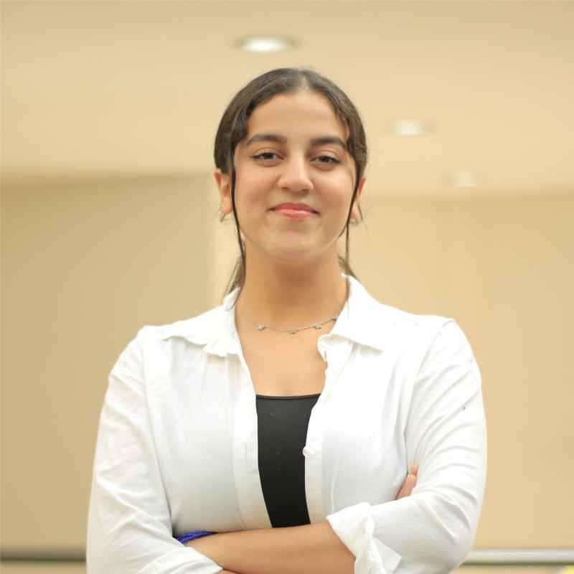

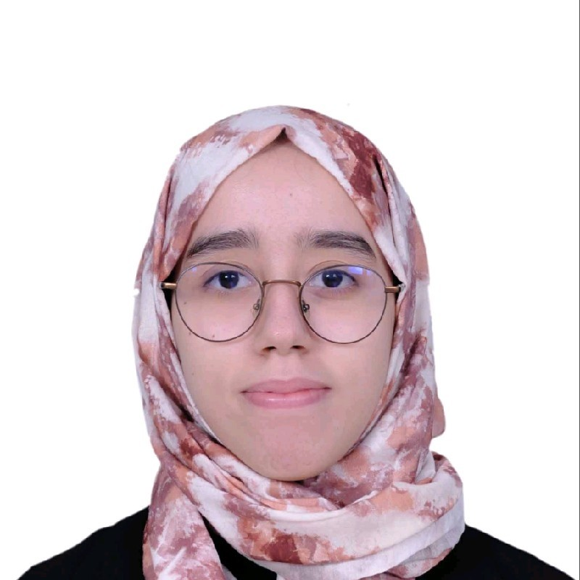
Data Collection
Yassine Oubenmoh 1st year computer science student
Omar Defaoui 2nd year computer science student
Interviews
Hamza Alaoui 2nd year computer science student
Najwa Berras 2nd year computer science student
Yassine Oubenmoh 1st year computer science student
Nour-Elhouda Guendoula 2nd year computer science student

Slide 41
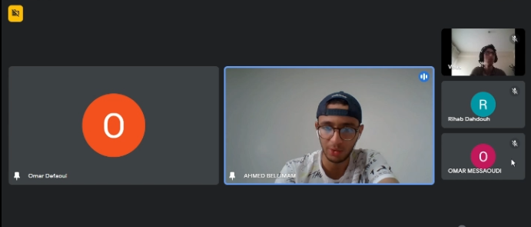
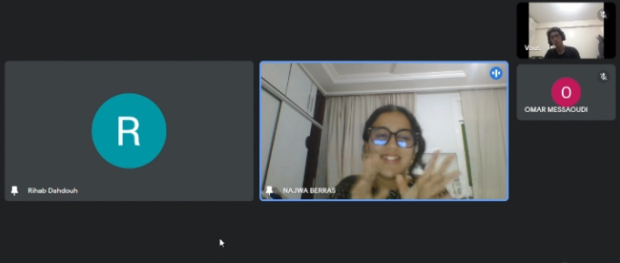


Interviews
We did virtual interviews with four 2nd year and two 1st year computer science students
Omar Defaoui 2nd year computer science student
Najwa Berras 2nd year computer science student
Yassine Oubenmoh 1st year computer science student
Hamza Alaoui 2nd year computer science student
Nour-Elhouda Guendoula 2nd year computer science student
Rim Jayed 1st year computer science student

Slide 42
Interviews
We did virtual interviews with four 2nd year and two 1st year computer science students
Yassine Oubenmoh 1st year computer science student
Omar Defaoui 2nd year computer science student
Each interview lasted from 8 to 10min
We opted for verbatim transcription (word for word)
Yassine Oubenmoh 1st year computer science student
Hamza Alaoui 2nd year computer science student
Najwa Berras 2nd year computer science student
Nour-Elhouda Guendoula 2nd year computer science student

Slide 43

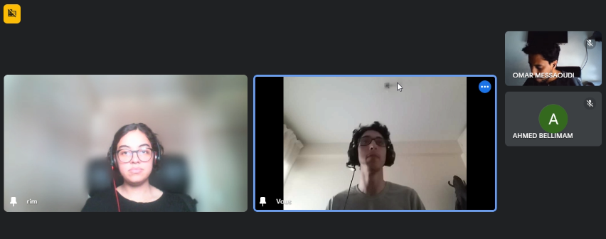
Interviews

Slide 44
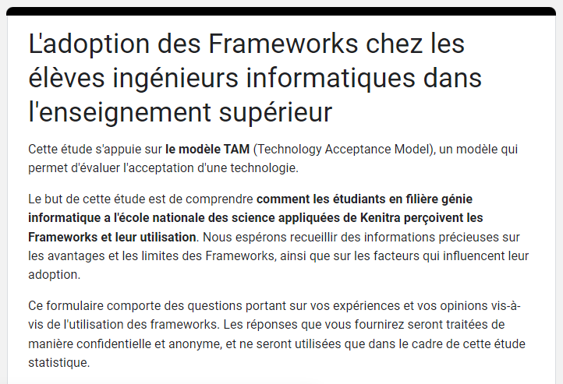
Interviews

Slide 45
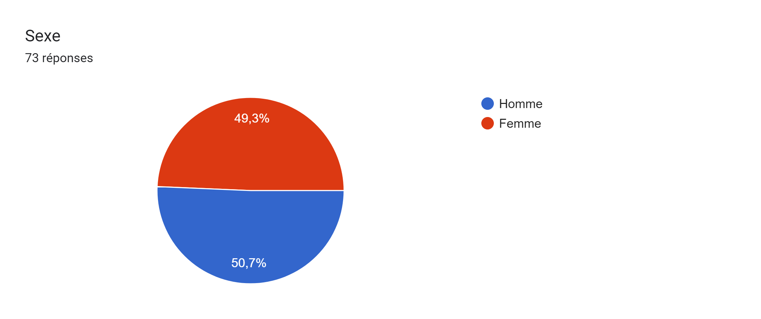
Form

Slide 46
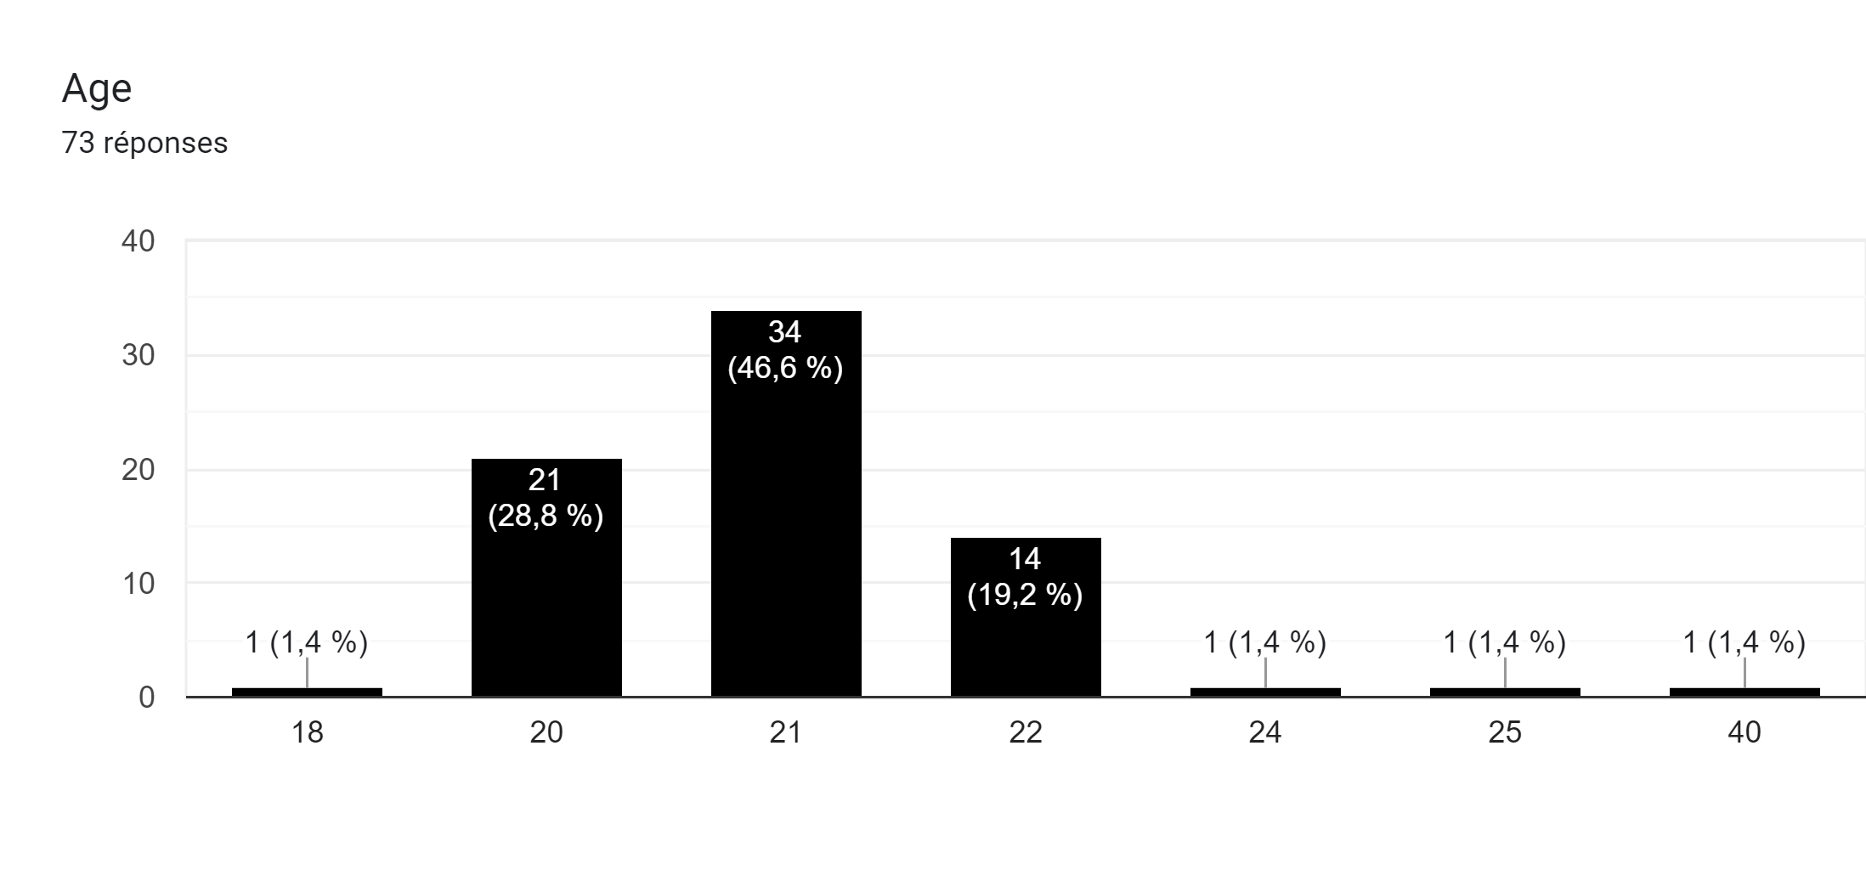
Form

Slide 47
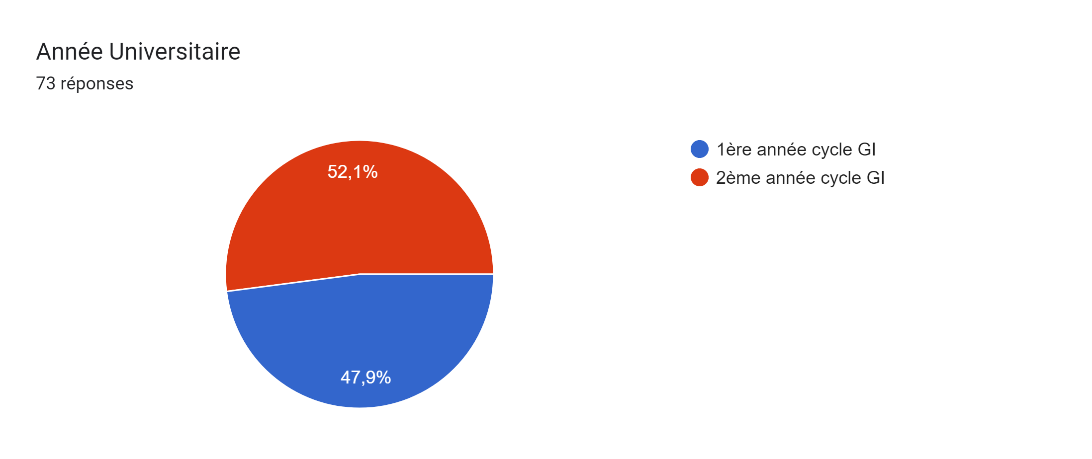
Form

Slide 48
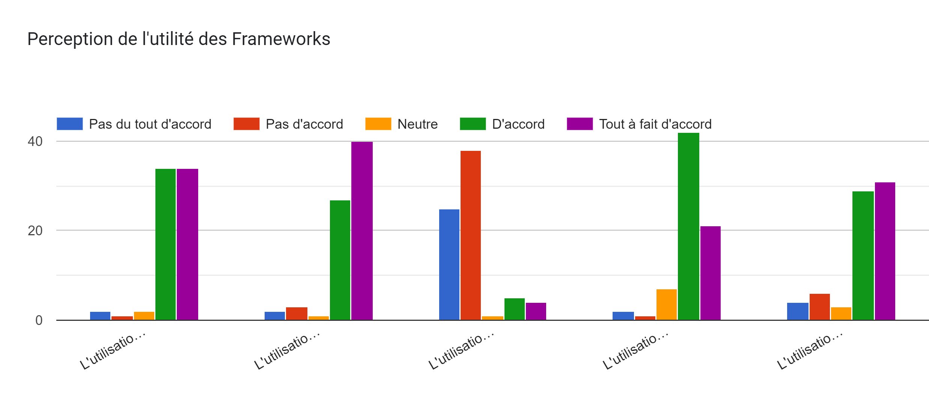
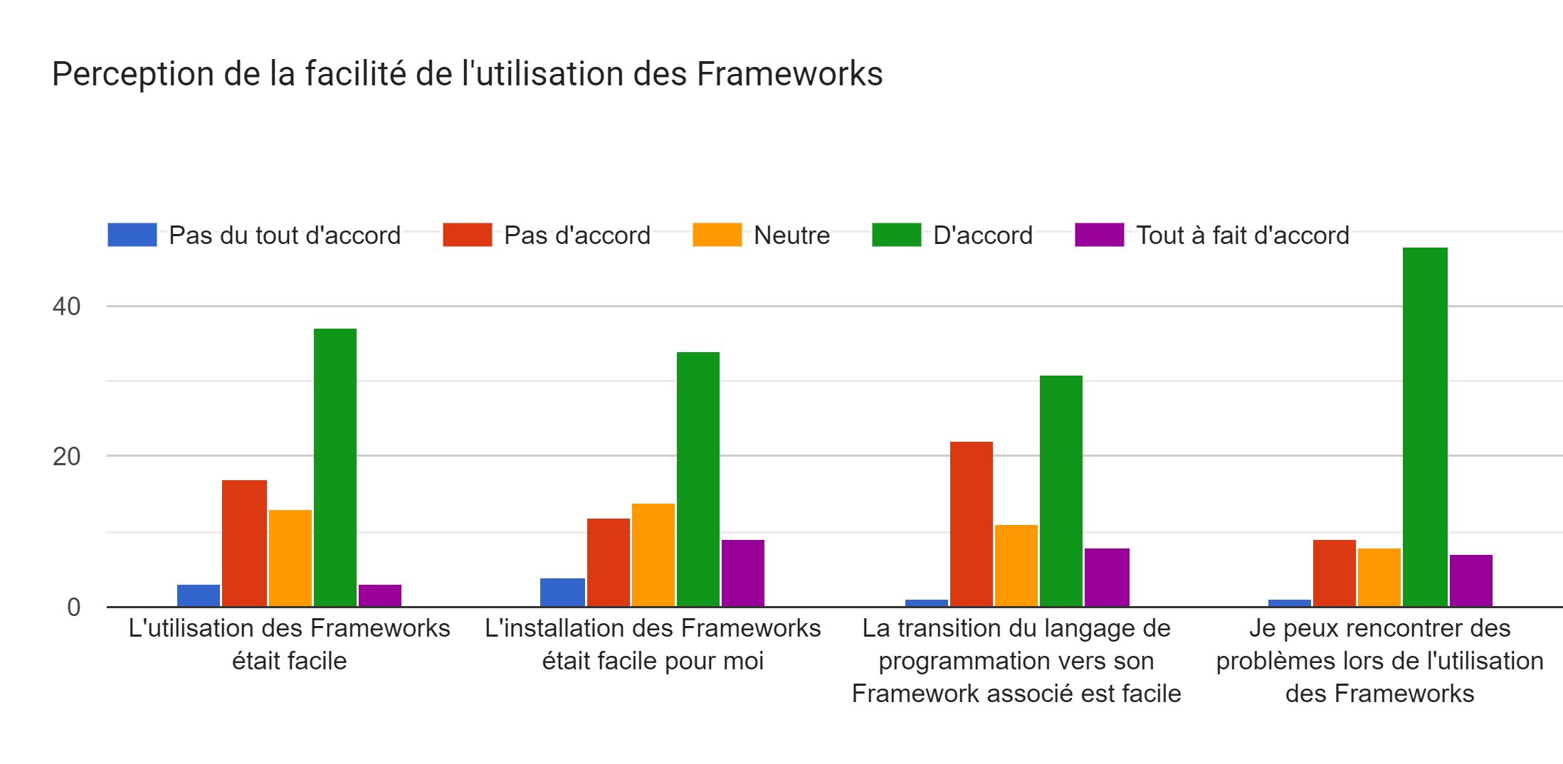
Form

Slide 49
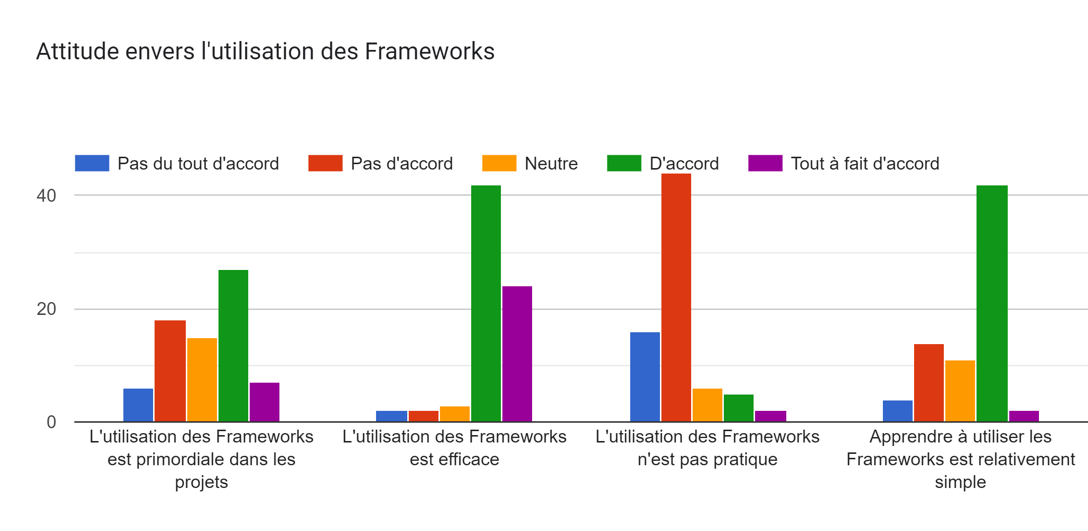
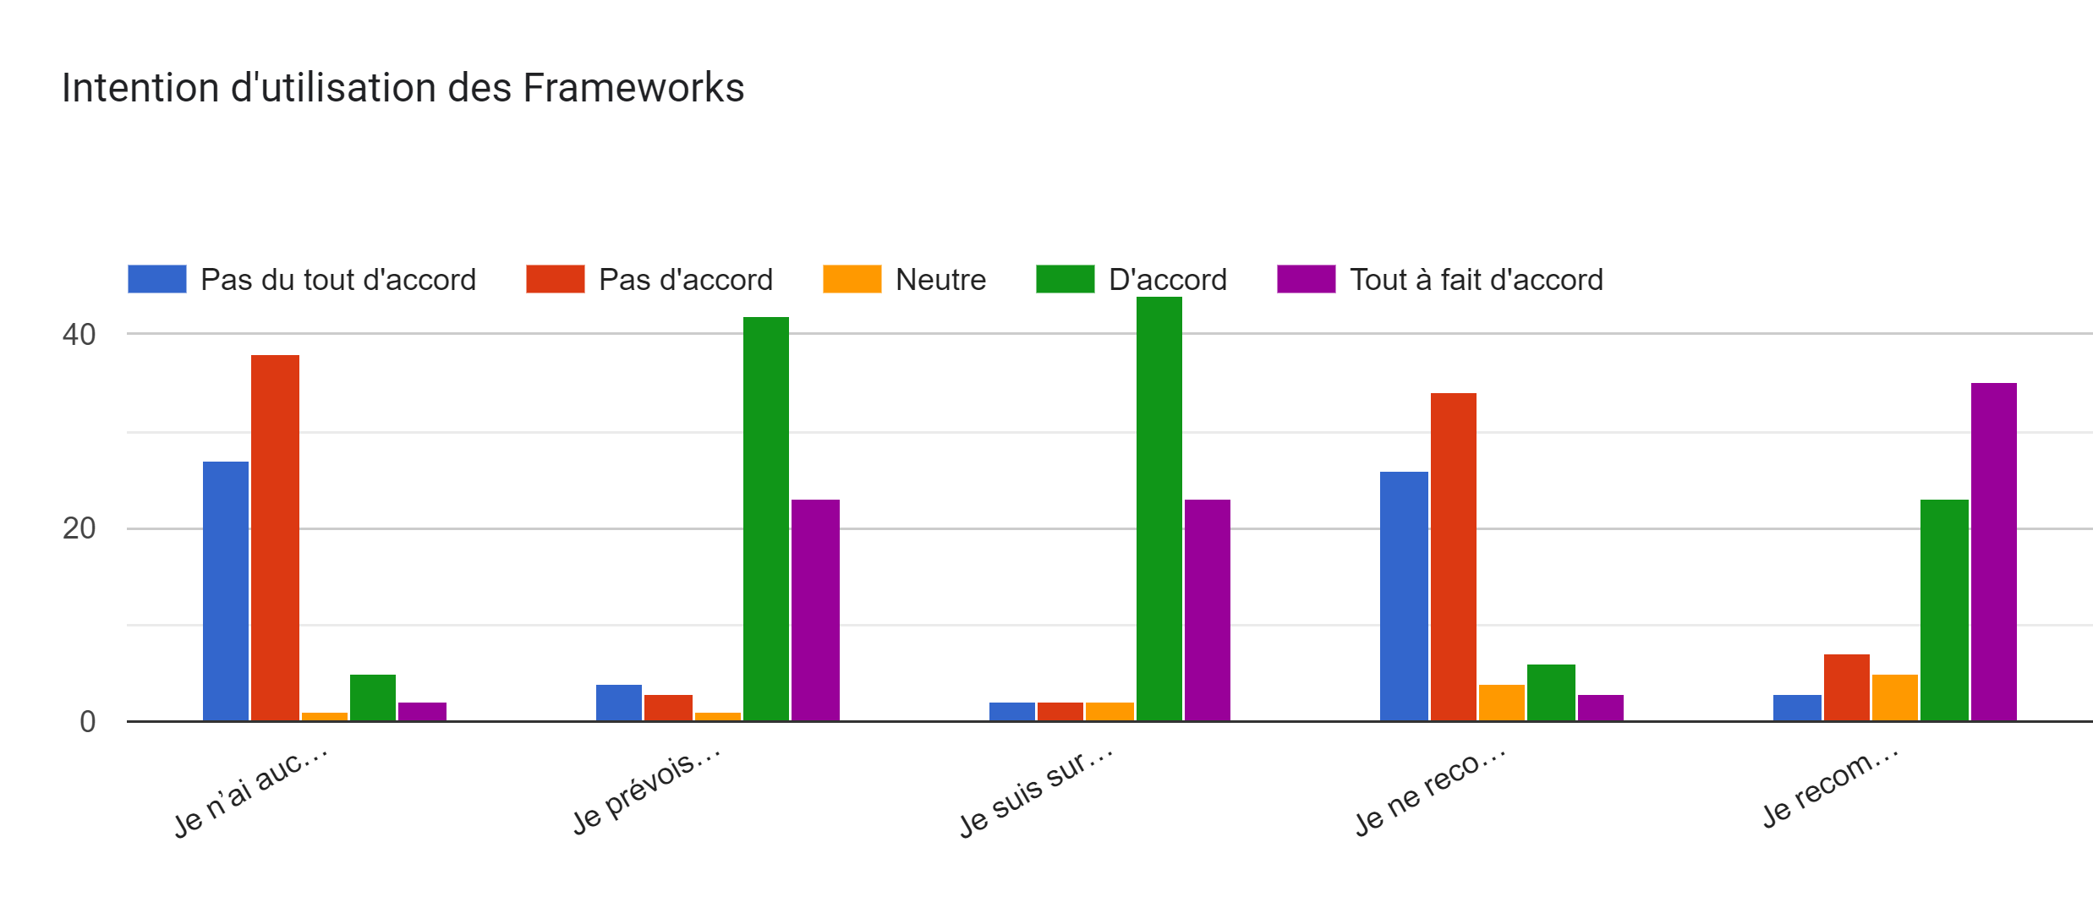
Form

Slide 50
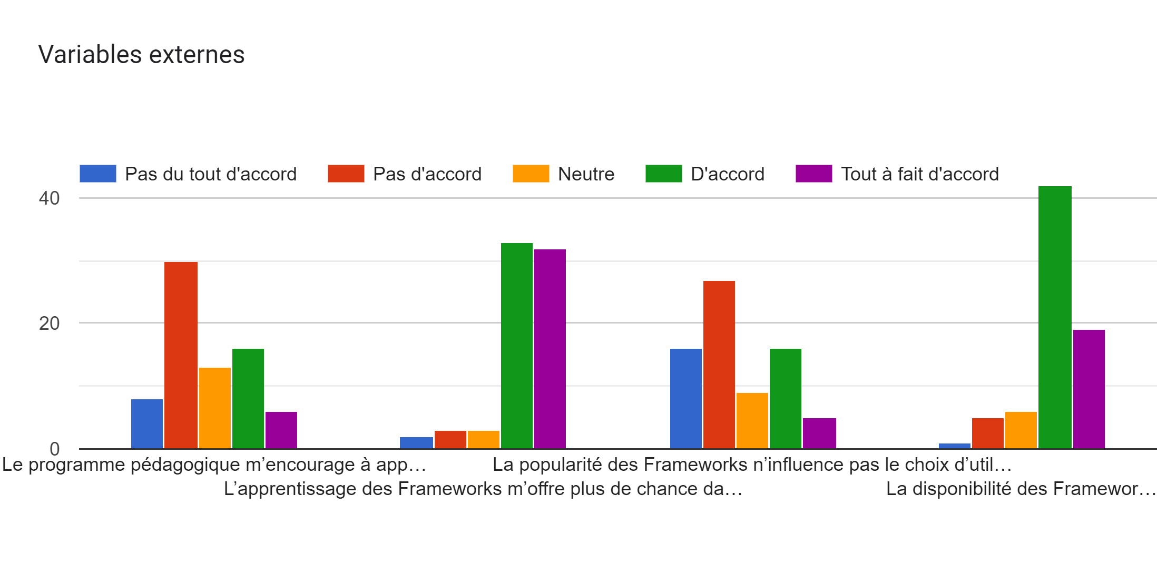
Form

Slide 51

Conceptual Data Model
Form

Slide 52
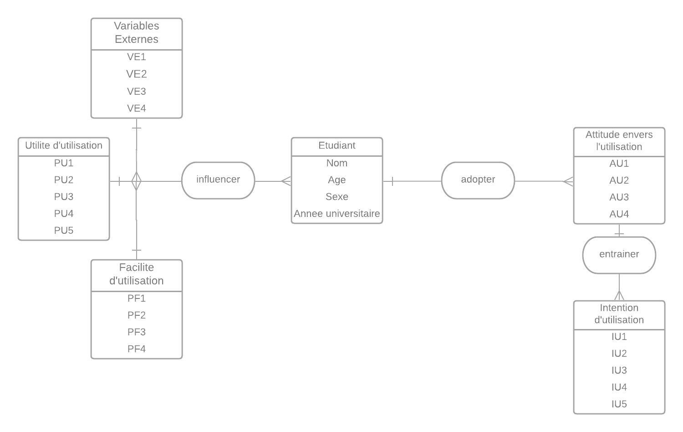

The Code
Form
Conceptual Data Model

Slide 53
Conceptual Data Model
The Code

Slide 54
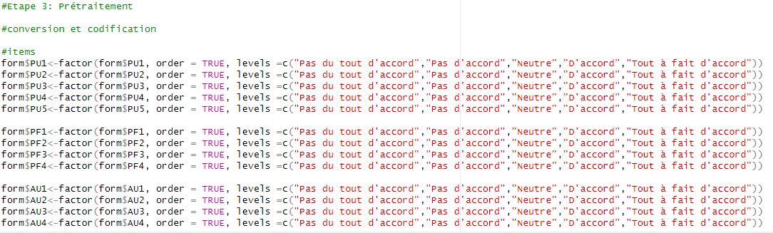
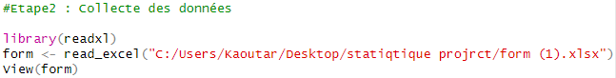
The Code
Data importation

Slide 55
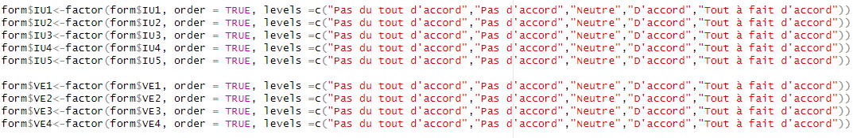
Data conversion

Slide 56
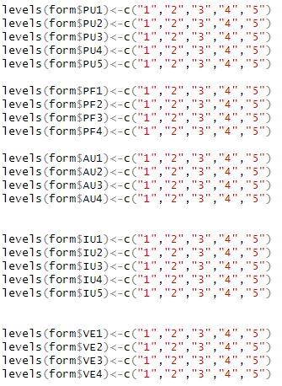
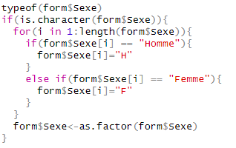
Data conversion

Slide 57
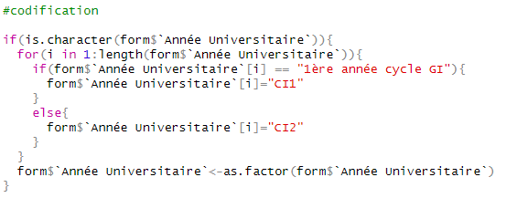
Data conversion

Slide 58
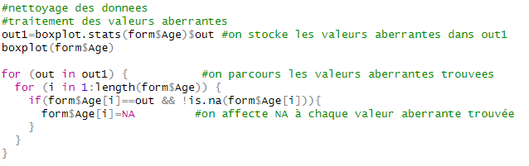
Codification

Slide 59
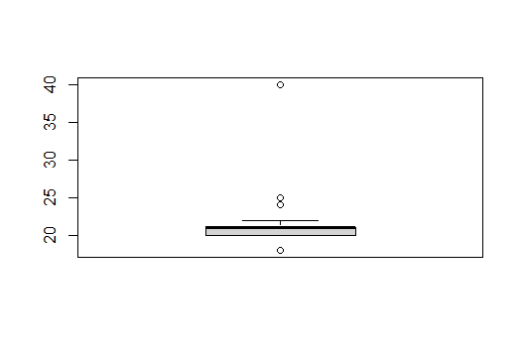
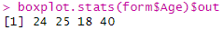
Data cleaning

Slide 60
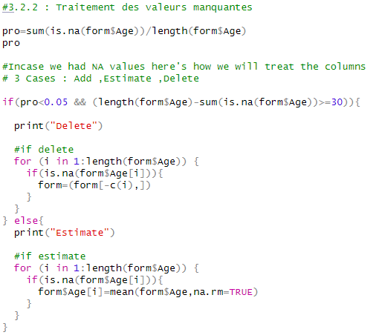
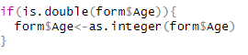
Data cleaning

Slide 61
Data cleaning

Slide 62
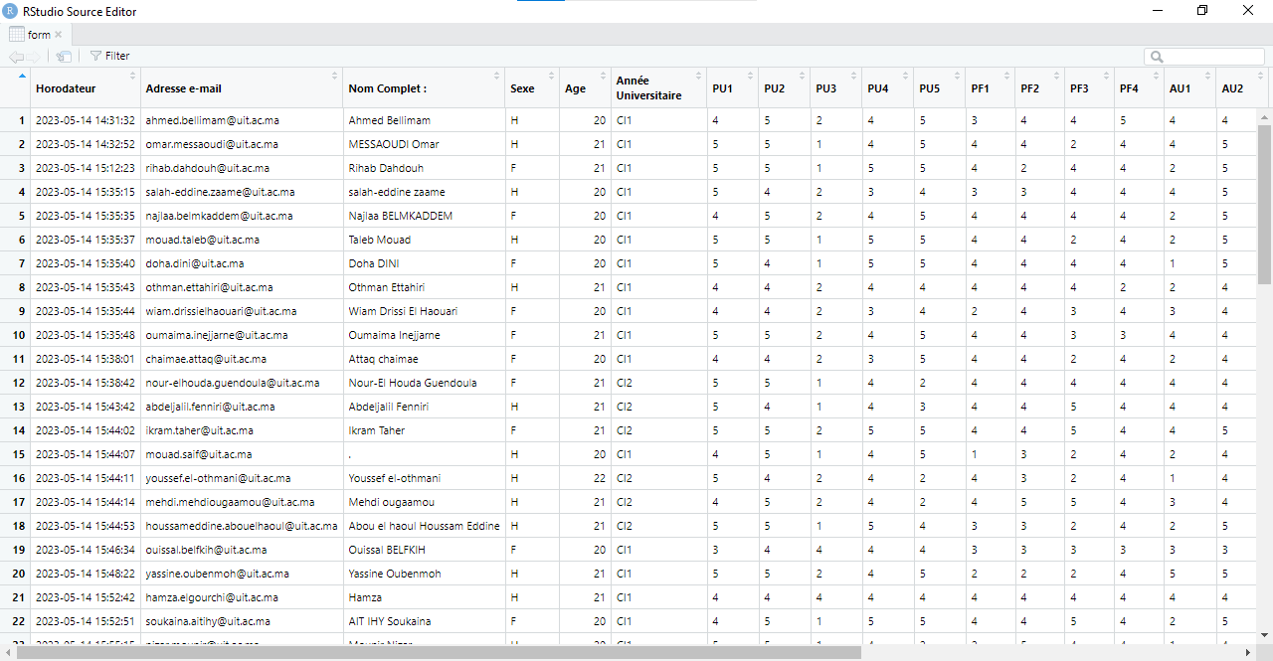
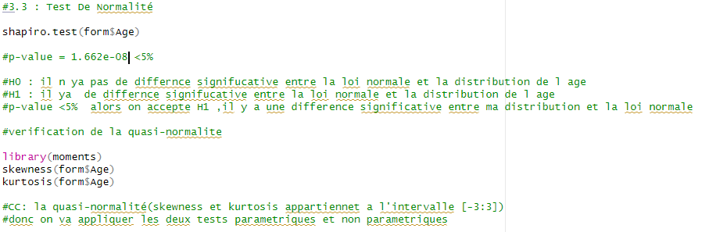
After Data cleaning

Slide 63
Normality Test
The Age does not follow the normal distribution

Slide 64
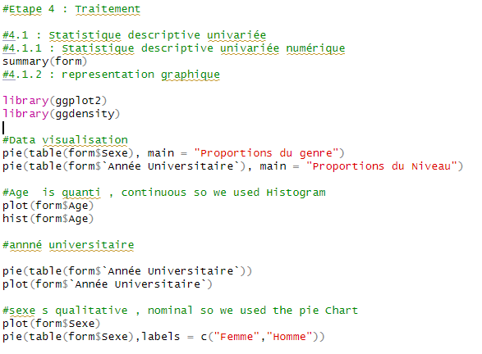
Data treatment

Slide 65
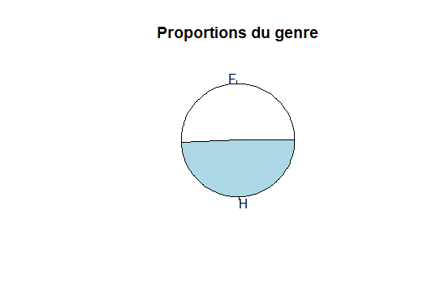

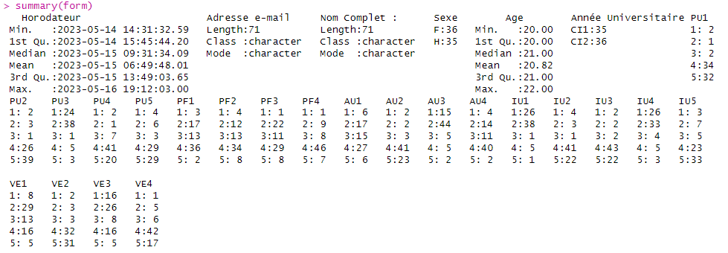
Data treatment

Slide 66
Data treatment

Slide 67
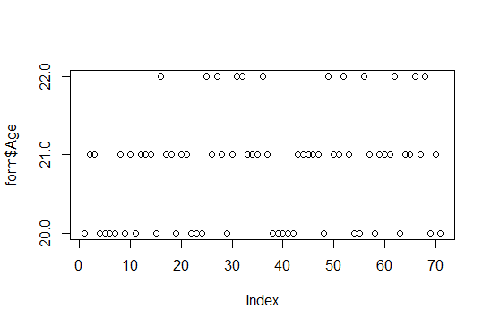
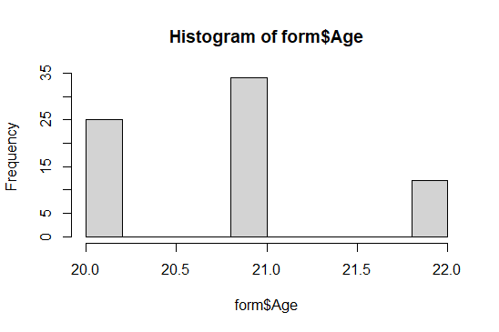
Data treatment

Slide 68
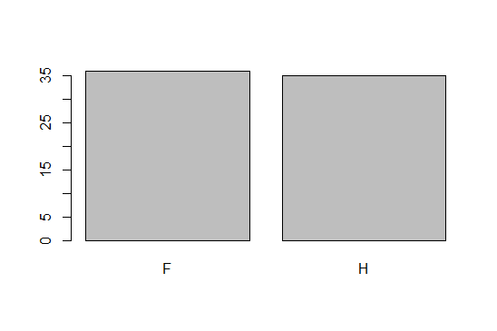
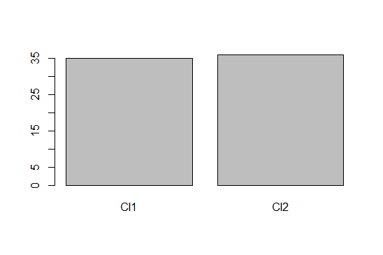
Data treatment

Slide 69
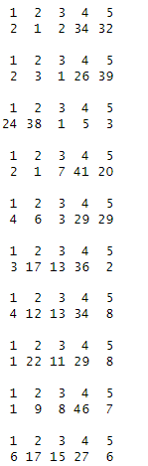
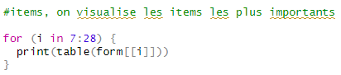
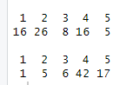
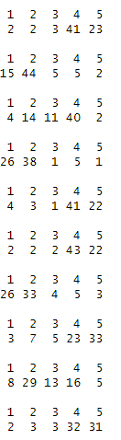
Data treatment

Slide 70
Data treatment

Slide 71
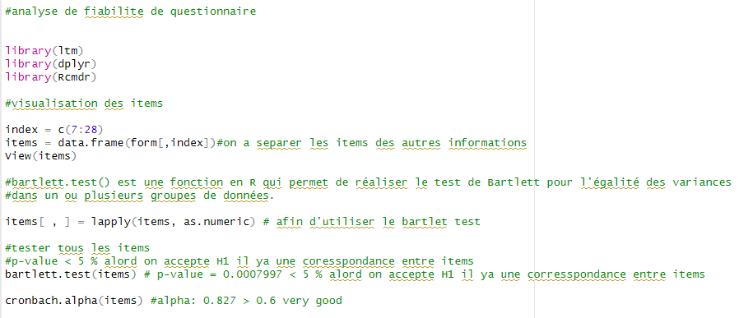
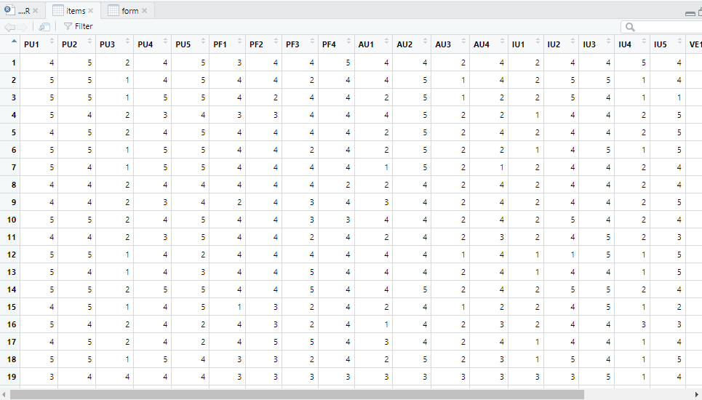
Reliability of the form

Slide 72
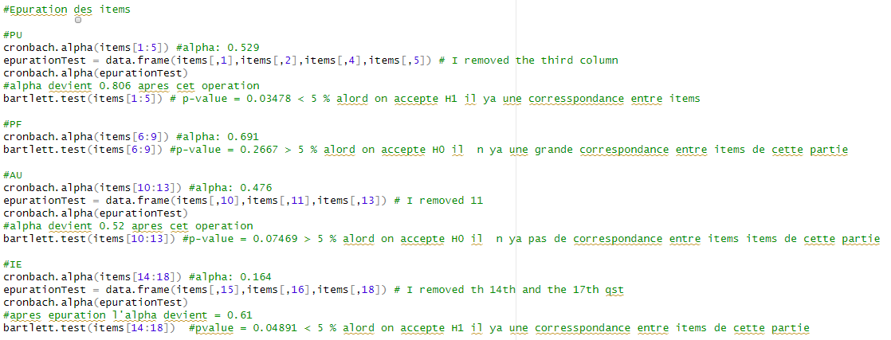
Reliability of the form

Slide 73
Internal Consistency

Slide 74
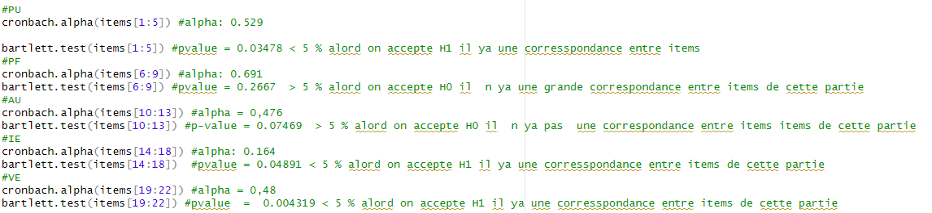
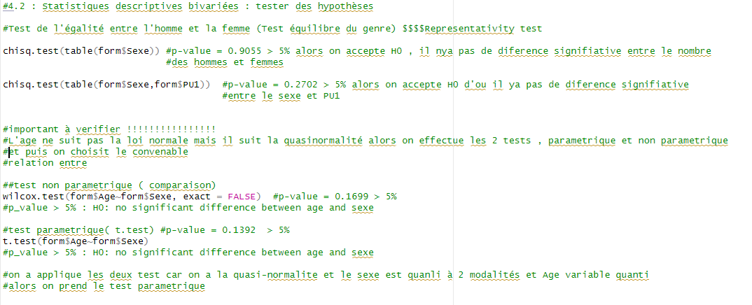
Purging the Items

Slide 75
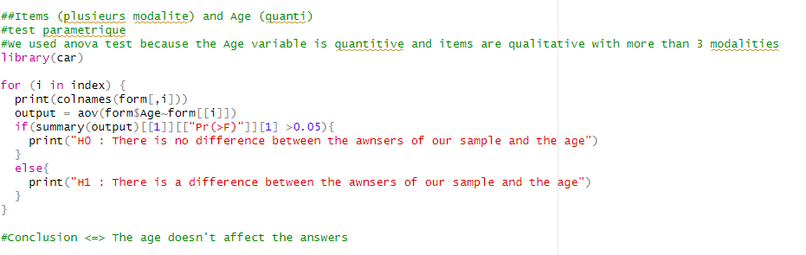
Bivariate descriptive statistics

Slide 76

Bivariate descriptive statistics

Slide 77

Bivariate descriptive statistics

Slide 78

Bivariate descriptive statistics

Slide 79
Bivariate descriptive statistics

Slide 80

Hypothesis’ tests

Slide 81

Hypothesis’ tests

Slide 82

Hypothesis’ tests

Slide 83

ACP

Slide 84
ACP

Slide 85


Slide 86
Thank You for your attention

